Slide 1


Netflix Dataset Analysis
Harsh More B.Tech Mechanical MIT Manipal
AICTE ID - STU682d64896b6471747805321

Slide 2
Objective and Scope
Netflix has become one of the largest streaming platforms globally with thousands of movies and TV shows. The goal is to analyze Netflix's content catalog to understand strategic patterns—like how content types (Movies vs TV Shows) have evolved over time, which genres and ratings are most common, and which countries contribute the most content—by exploring the dataset with Python and creating meaningful visualizations.

Slide 3

PROBLEM STATEMENT
Netflix faces intense competition from platforms like Amazon Prime, Disney+, and regional OTT providers. To maintain its market leadership, Netflix must strategically analyze its content catalog to identify strengths, gaps, and opportunities.
Key Questions to Address:
How has the distribution of Movies vs TV Shows changed over the years?
What are the most common genres and content ratings on the platform?
Which countries are the top contributors to Netflix's global catalog?
What insights can guide Netflix's content acquisition and production strategies?

Slide 4
Project Description I analyzed the Netflix dataset containing 7,789 records across 11 columns using Python. First, I cleaned and preprocessed the data, handling missing values and extracting useful features like release years. Then, I performed comprehensive exploratory data analysis to uncover insights about content distribution, genre trends, country contributions, and rating patterns. I created multiple visualizations including distribution charts, trend analysis graphs, and comparative plots to make the findings clear and actionable. All code was written in VS Code following best practices for data analysis.

Slide 5

WHO ARE THE END USERS?
Data Analysts and Business Intelligence Teams who need to understand content trends and make data-driven recommendations for content strategy.
Content Acquisition Teams who want to know which genres, countries, and content types perform well to guide future licensing and production decisions.
Netflix Executives and Strategists trying to optimize the content portfolio, identify market gaps, and compete effectively against rival streaming platforms.
Market Researchers studying the evolution of streaming content and entertainment industry trends.

Slide 6

Technology Used
Python Programming - Core language for data analysis because of its powerful libraries and ease of use.
Pandas - For data cleaning, manipulation, preprocessing, and statistical analysis of the 7,789-record dataset.
Matplotlib & Seaborn - For creating professional visualizations including pie charts, bar charts, histograms, and trend plots.
NumPy - For numerical computations and handling arrays efficiently.
VS Code - Development environment for writing clean, organized, and well-documented code.

Slide 7
Key Findings
Content Distribution: Movies dominate the catalog with approximately 70% of total content, while TV Shows make up 30%.
Geographic Analysis: United States, India, and United Kingdom are the top three contributing countries, accounting for over 40% of all content.
Content Rating Patterns: TV-MA (Mature Audiences) and TV-14 are the most common ratings, indicating Netflix's focus on adult and teenage demographics.
Temporal Trends: Netflix significantly increased content additions from 2015 onwards, with peak additions between 2017-2019.
Movie Durations: Average movie length is around 100 minutes, with most movies falling in the 90–120-minute range.

Slide 8
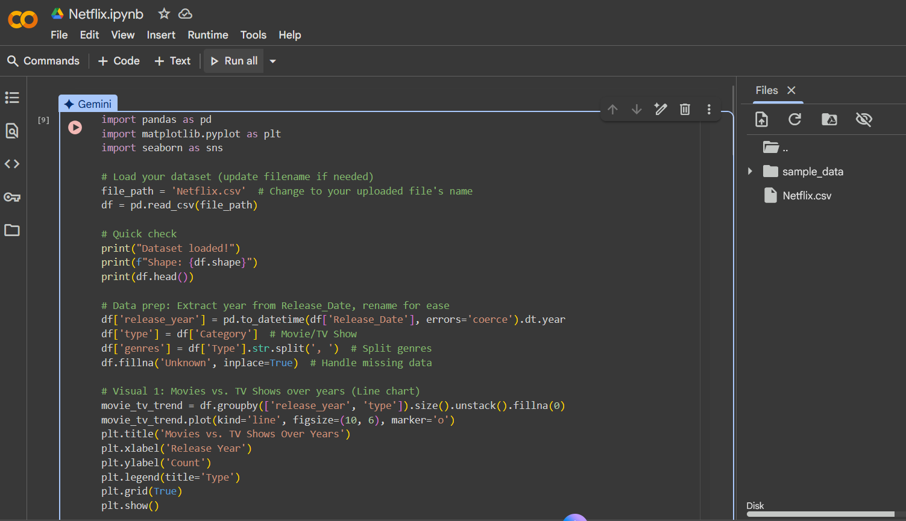
Code Snippets (used Google Collab)

Slide 9
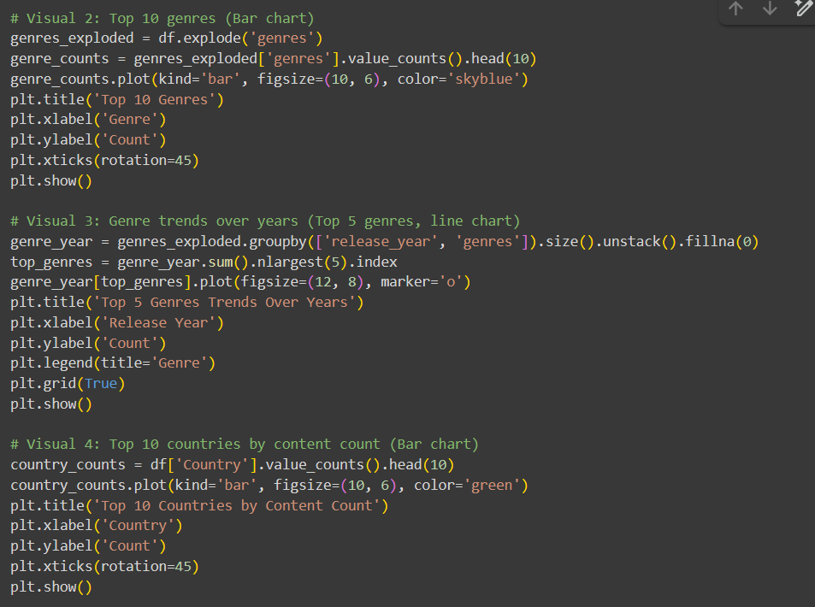

Slide 10
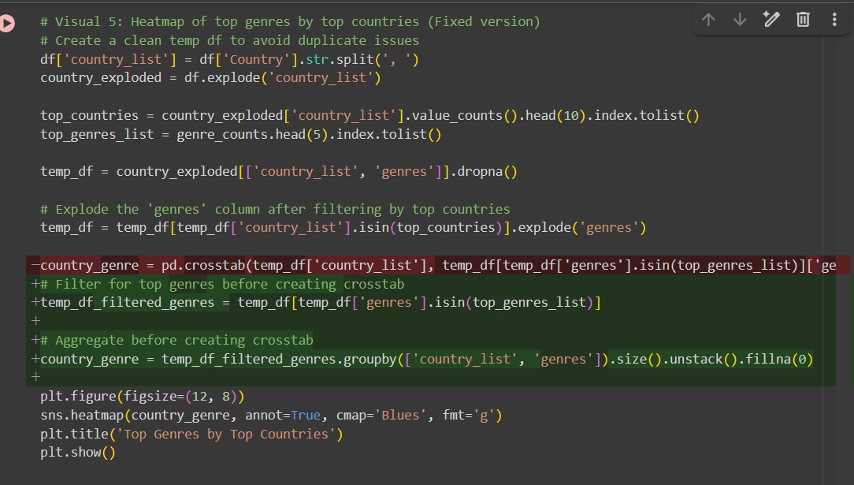
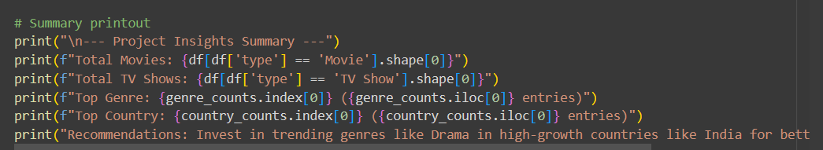

Slide 11
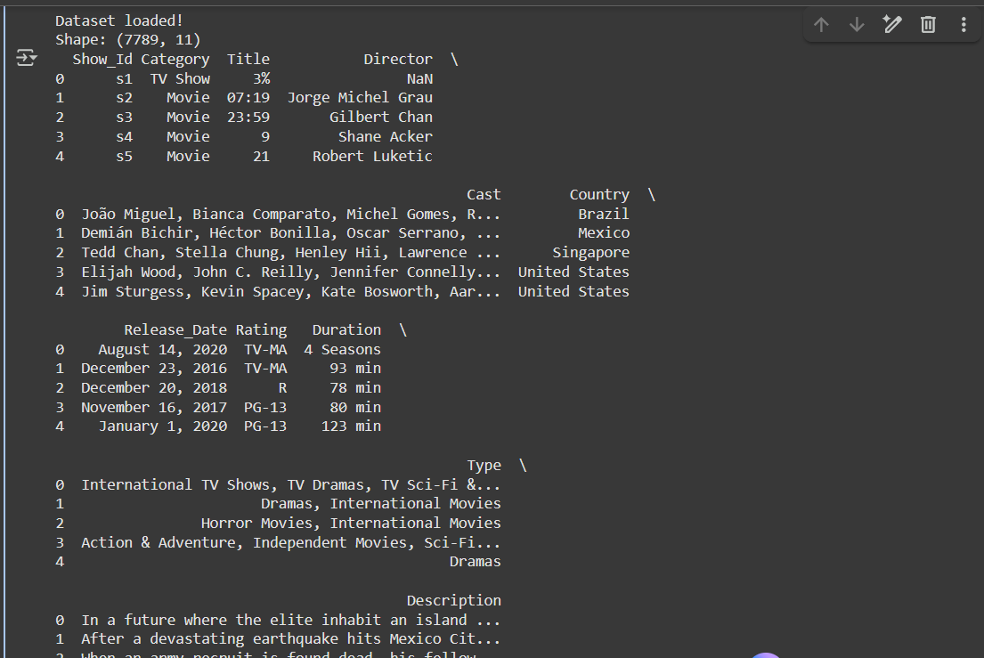
Terminal – Dataset Read

Slide 12
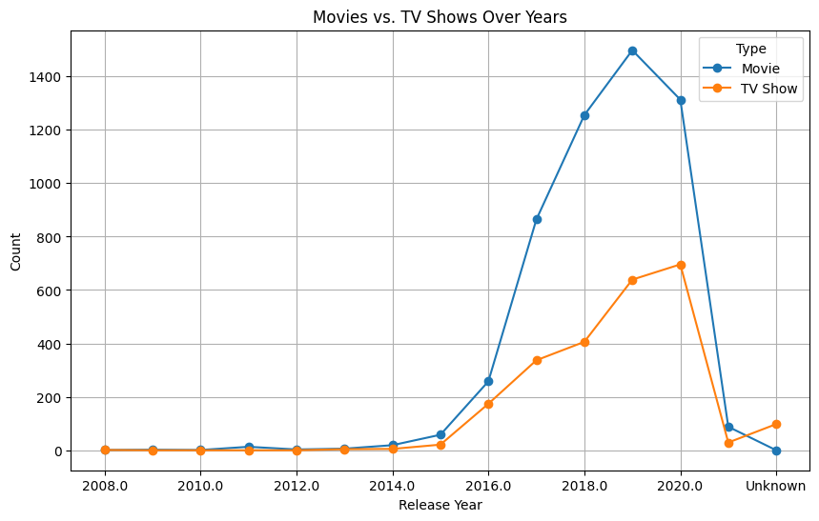
RESULT 1 – Movie VS TV Shows Comparison
[Add screen shots of your code or Chart(s) ]

Slide 13
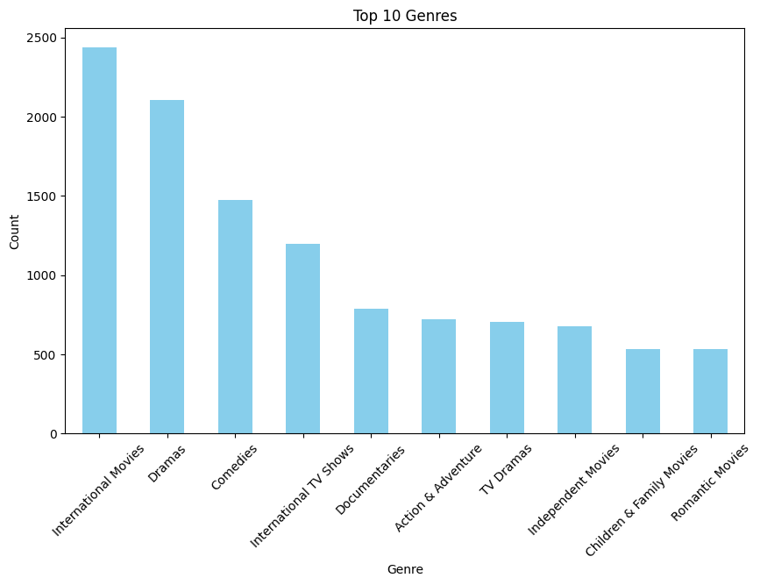
RESULT 2 – Genre wise Comparison

Slide 14
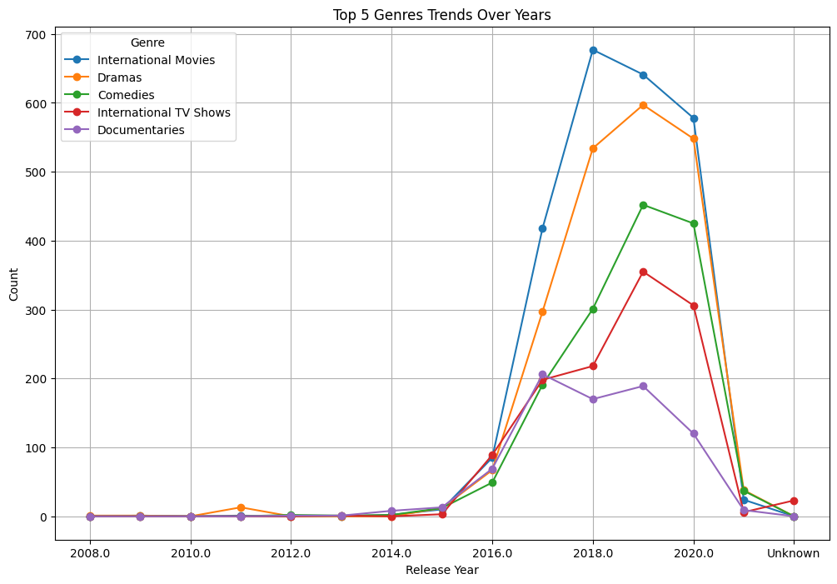
RESULT 3 – Genre Trends

Slide 15
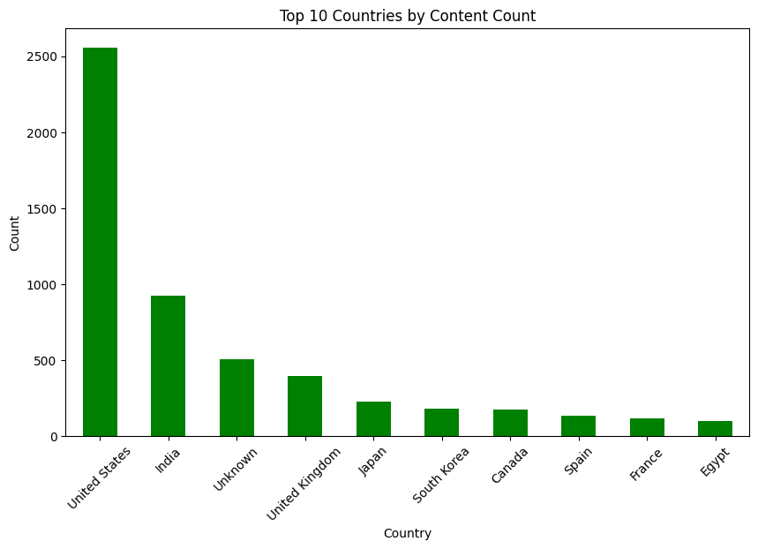
RESULT 4 – Country wise Comparison
[Add screen shots of your code or Chart(s) ]

Slide 16
GitHub repository
Repository Name: VOIS_AICTE_Oct2025_MajorProject_Harsh
Repository URL: https://github.com/CosmicStorm09/VOIS_AICTE_Oct2025_MajorProject_Harsh
Contents:
Complete Python analysis scripts
Netflix dataset (CSV file)
Generated visualizations (PNG files)
README with project documentation
Requirements.txt with dependencies

Slide 17
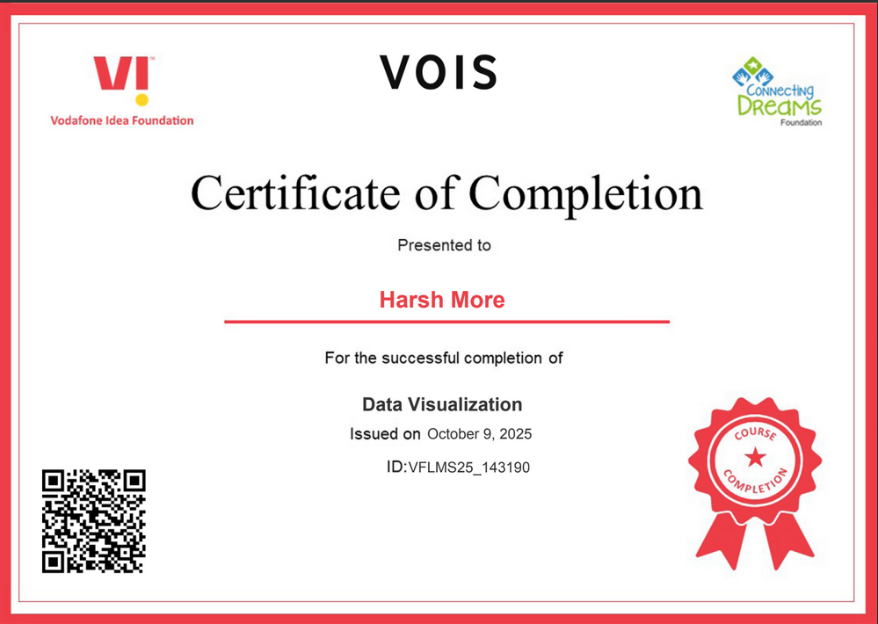
Data Visualization Certificate

Slide 18

Getting started with Basics of Python Certificate

Slide 19

Getting Started with Python Environment Installations

Slide 20

Building Blocks Of Python

Slide 21
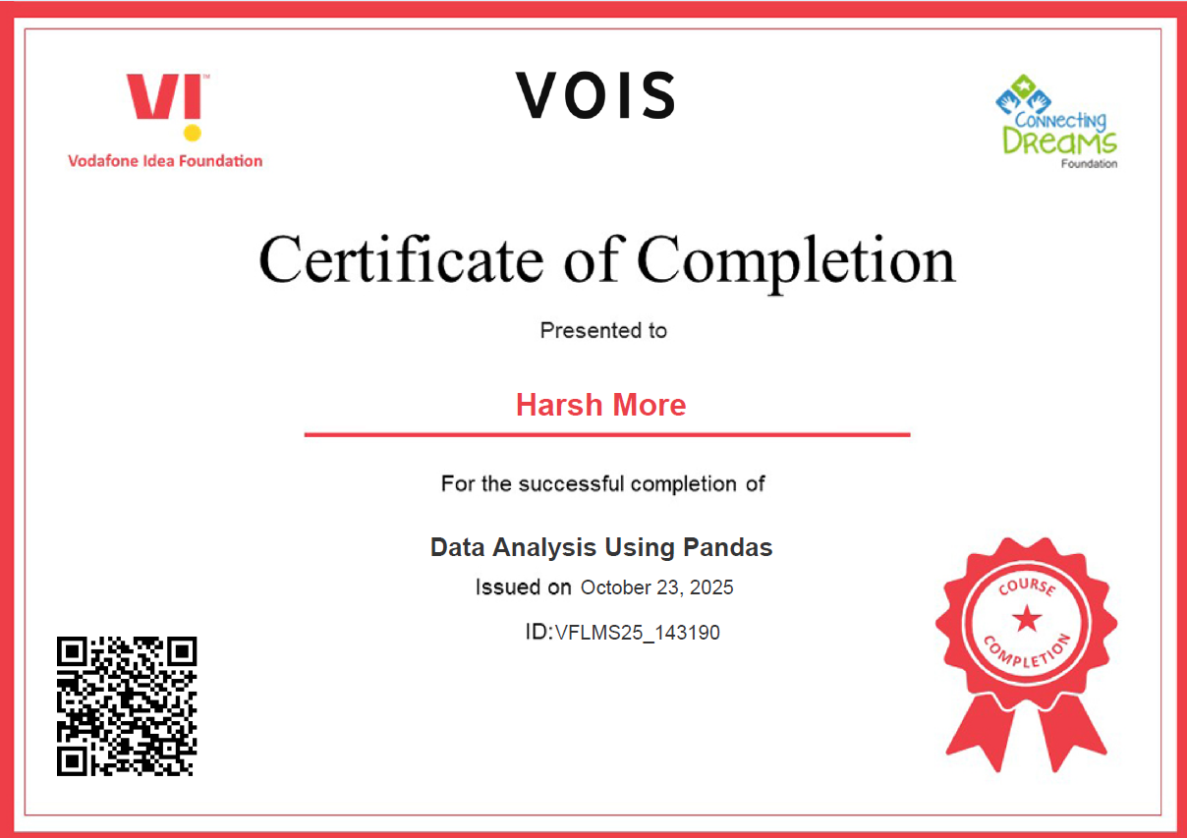
Data Analysis Using Pandas

Slide 22

Basics of Linux Operating System

Slide 23
Thank You!
Harsh More B.Tech Mechanical MIT Manipal
Contact: more_harsh@yahoo.com
.
.

